Slide 1



Integrated Program in Business Analytics
Patient Survival Analysis
Group H
Orooj, Swapnil, Nikhil, Ashutosh
Babli, Shubhi, Suruchi

Slide 2
Agenda
Business Problem and Objectives
Executive Summary
Data Overview and Key Business Assumptions (if any)
Data Preparation and Pre-processing
Sanity checks, treatment and transformations for analytical dataset preparation
Exploratory Data Analysis
Key Business Findings and Insights
Model Development and Validations
Model comparisons on key scoring metrics and model finalization
Dashboarding (required only when it is in scope of analysis)
Business Recommendations and Potential Business Impact
Next Steps
Appendix

Slide 3



Business problem and objectives
Healthcare business long term profitability depends on patient retention or time on therapy. We aimed to create a working model for analysis that can help us estimate the patient time on therapy.
How to estimate time on therapy for patients?
Is it possible to calculate customer lifetime value?
Study and implement the survival analysis modelling technique from scratch.
Build a simulation model structure.
Implement tools and techniques we learned in the IPBA program.

Slide 4
Executive summary
Our project is built on the foundation of research and collaboration.
Through survival analysis we can help business estimate customer lifetime value, the same can be leveraged to forecast patient time on therapy.
There were 4 main challenges in front of the team:
Data procurement, Self study of survival analysis technique, Business logic implementation, Create simulation structure to provide answer to business in different scenarios
The team was successfully able to overcome these challenges and create a working model to answer the above questions.
The existing solution has 2 parts, the first part is the simulation to generate data depending on different situations and the second is survival model; both of these can be used together or independently.
We recommend use of the existing solution as a support structure in decision making coupled with real world data, the other major use will be to replicate the patterns of the real world data to the existing simulation (modification required) and see the affects on patient time on therapy.

Slide 5
Data Overview and Key Business Assumptions (if any)
Simulated APLD (anonymized patient level data) with assumptions and fields including but on limited to those below.
Assumptions
Paid claims only
Type II diabetes patients only
4 year study period (2019-2022)
Patients with duplicate records removed
Derivation of the 2 KPIs
tot : time on therapy (first day supply till last day of supply)
survived : weather the patient was active or not by end of our study
Survival assumption (0,1) related to patients last day of supply of drug
Field | Description
patient_id | Patient unique ID
service_date | Date when the claim was adjudicated
claim_type | Paid, rejected or reversed claim
days_supply | Number of days drugs was supplied for
patient_birth_year | Date of Birth of Patient
gender | Gender of Patient
disease_type | T1: Type I or T2: Type II diabetes
drug_name | Brand name of the drug
class | Category of Drug
sub_class | Sub Category of Drug
past_medical_history | Yes or no
family_history | Of diabetes, Yes or no
is_there_complication | Yes or no
marital_status | Married, Unmarried
educational_status | Educated, Uneducated
employee_status | Employed, Not Employed

Slide 6
Data Preparation and Pre-processing: Simulation
The analyst can change the python simulation or the mapping file resulting in different sets of data.
Data Preparation
Analyst
Simulation (.py)
Mapping (.xlsx)

Slide 7
Data Preparation and Pre-processing: Overview
The below filters were applied before building the model including creation of important KPI
Data Pre-processing
Filters
Disease type (Type II only)
Claim type (Paid claims only)
Time frame (4 years, 2019-2022)
Missing value check
Duplicate value check
Deriving relevant features
TOT (time on therapy)
Survival flag
Patient age

Slide 8
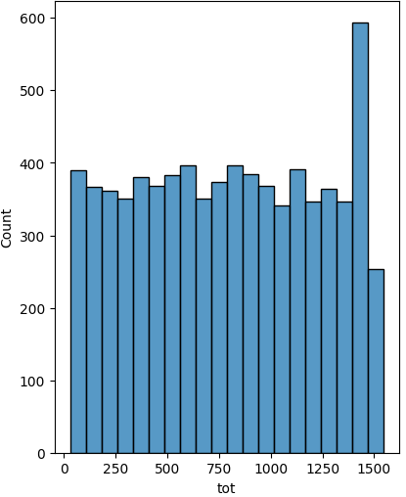
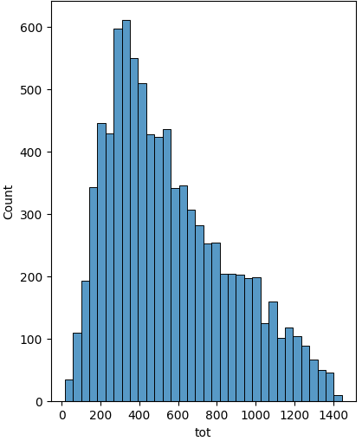
Exploratory Data Analysis: Overview
EDA is most relevant as a comparison between outcomes of the two simulations.
There is major difference in the data distribution between first and second simulation
The second simulation being closer to real world situations implying we can modify the simulation code in python and create scenarios
Simulation 1
Simulation 2
Observation | Simulation 1 | Simulation 2
# of patients under study | ~10,000 | ~10,000
% patient discontinued (did not survive) within period of study | 90% | 76%
Mean TOT (time on therapy) | 791 days | 556 days
Std dev TOT (time on therapy) | 436 | 310
Qualifying patient count | ~7,500 | 8,700

Slide 9
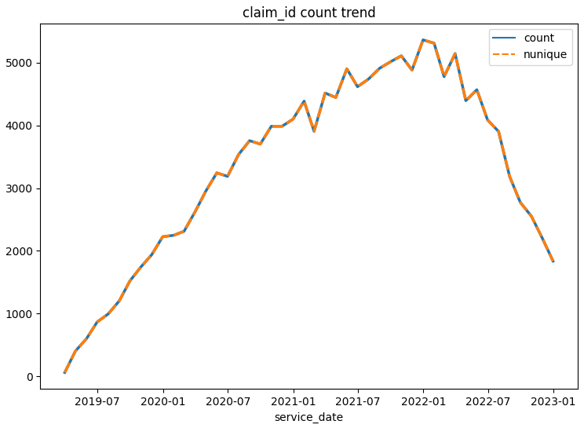
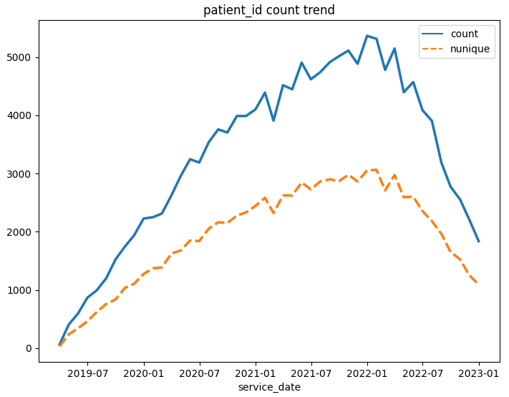
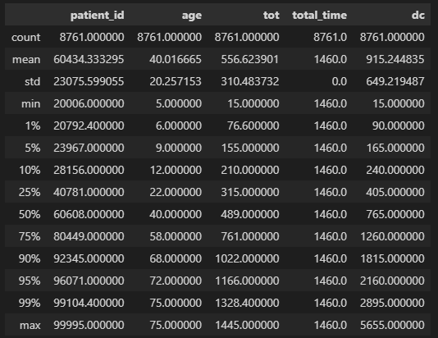
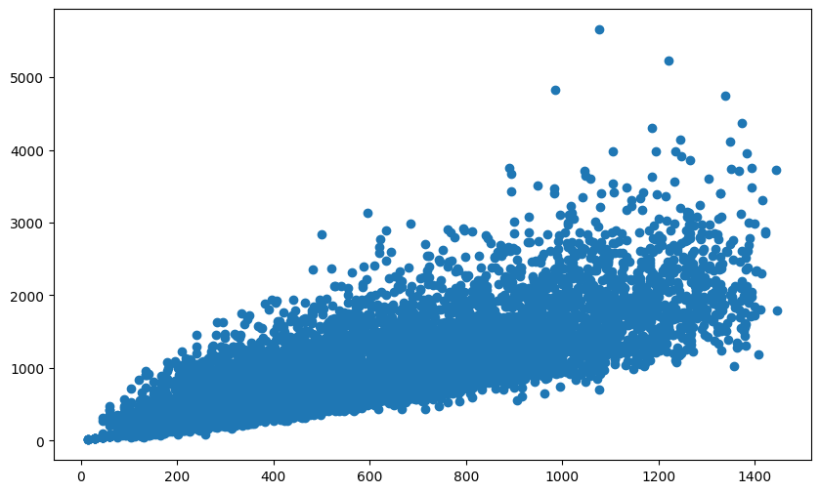
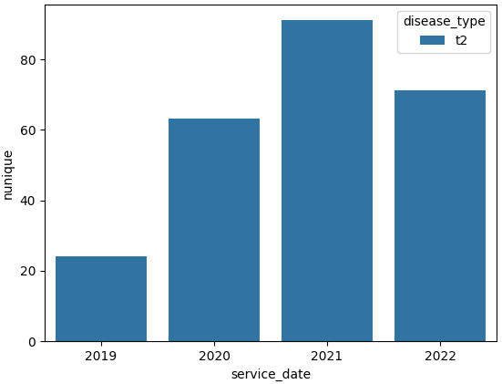
Exploratory Data Analysis: Data Distribution
Simulation 2
EDA done for each field, involving
Duplicate record treatment
Trend
Data Distribution

Slide 10
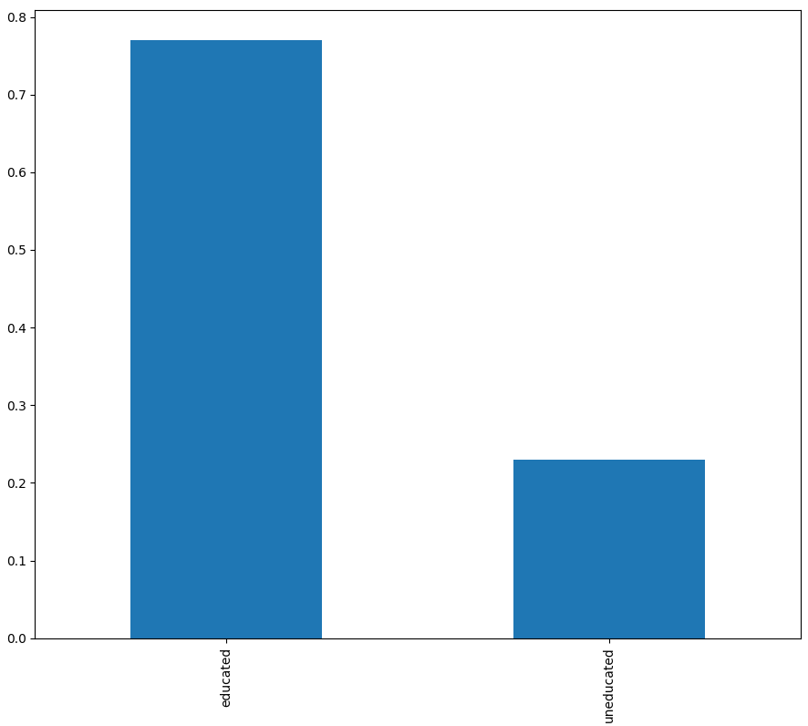
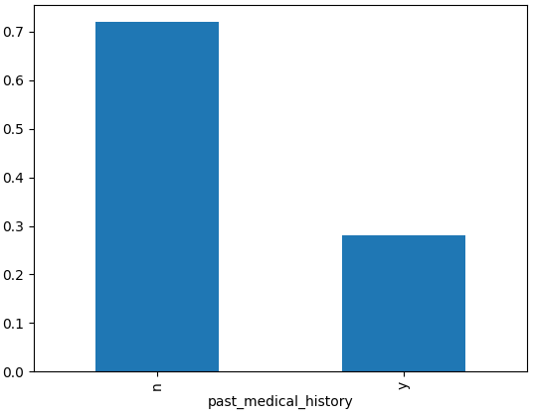
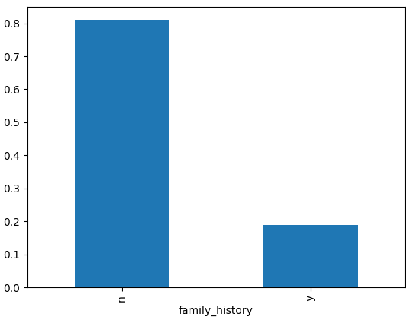
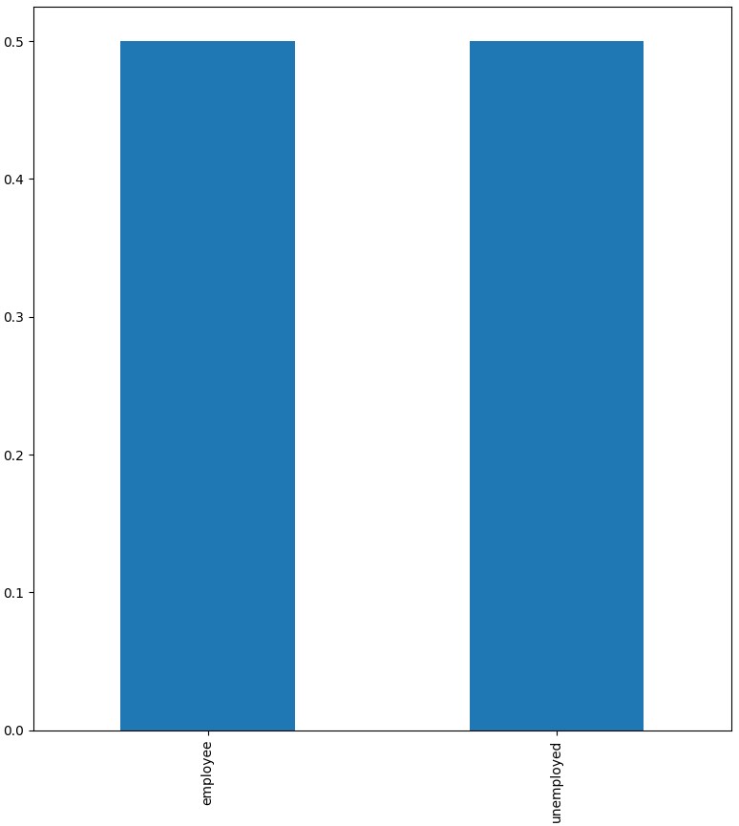
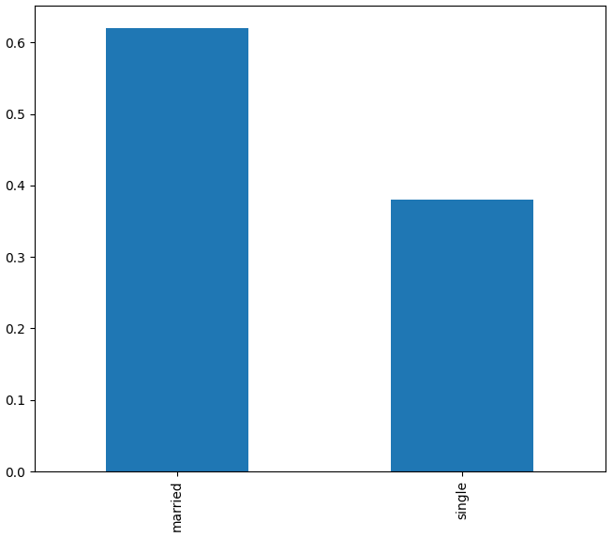
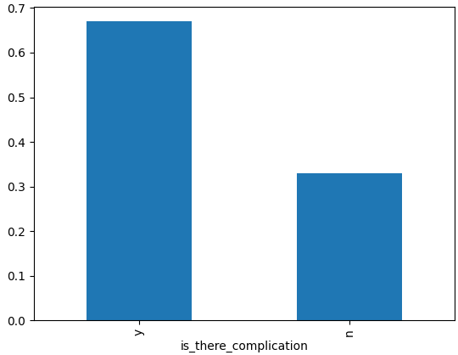
Exploratory Data Analysis: Patient Demographics
Survival Analysis on Time-To-Recovery of Diabetic Patients at Minlik Referral Hospital, Ethiopia: Retrospective Cohort Study

Slide 11
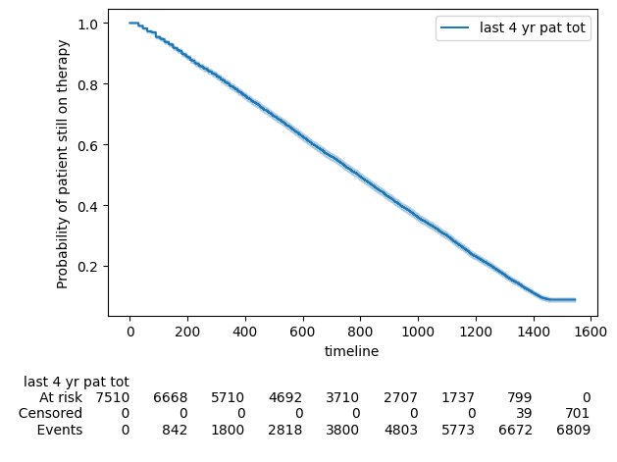
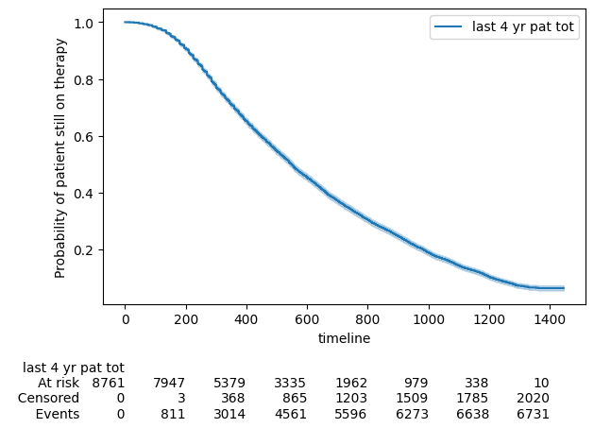
Model Development and Validations
Kaplan Meier Estimate
Simulation 1
Simulation 2
7510 total observations, 701 right-censored
Median survival time: 793 days
Median CI (95%): 774 - 808
8761 total observations, 2030 right-censored
Median survival time: 549 days
Median CI (95%): 540 - 557

Slide 12
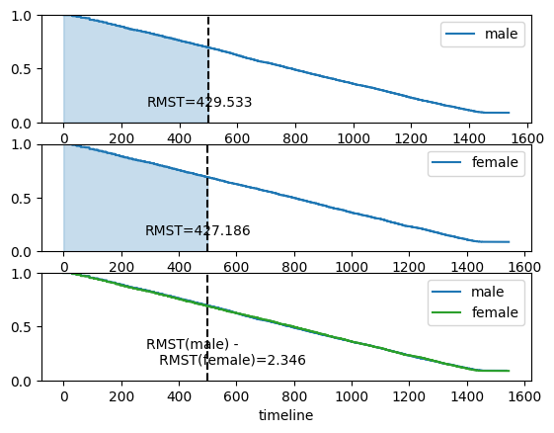
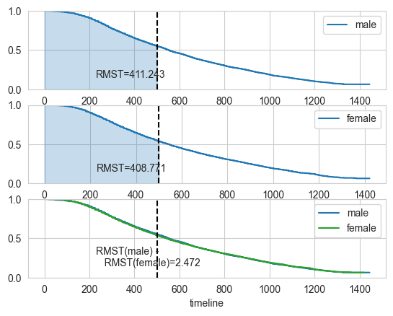
Model Development and Validations
Kaplan Meier Estimate: Efficacy of intervention
Simulation 1
Simulation 2

Slide 13
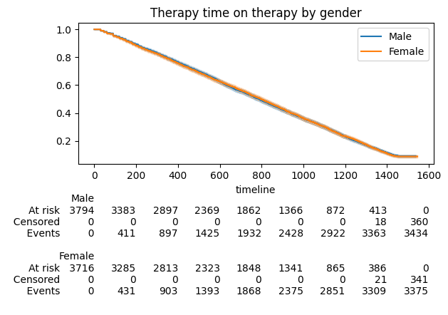
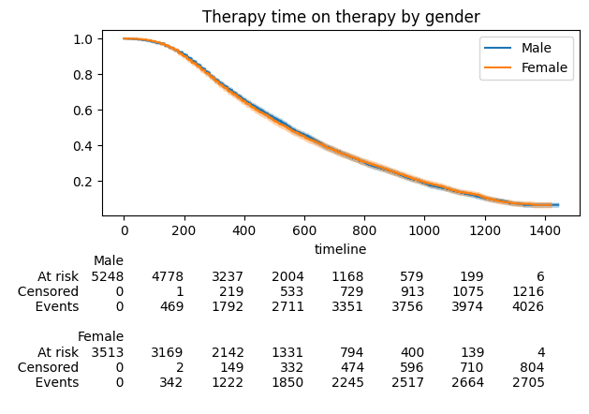
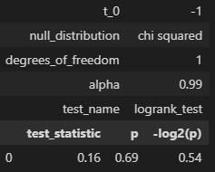
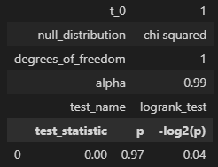
Model Development and Validations
Kaplan Meier Estimate: Comparison of patient groups
Simulation 1
Simulation 2

Slide 14
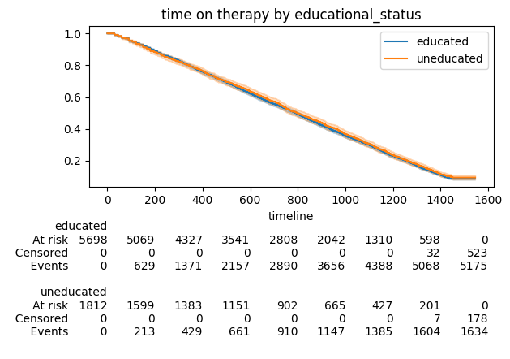
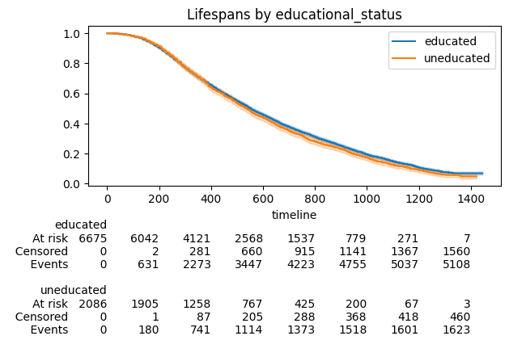
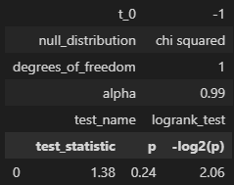
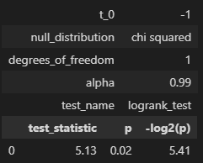
Model Development and Validations
Kaplan Meier Estimate: Comparison of Demographics
Simulation 1
Simulation 2

Slide 15
Business Recommendations and Potential Business Impact
The solution promises robust simulation model with a parsimonious KM estimate
The business can take advantage of the simulation logic and tweak it to real world scenarios.
The simulation can be improved and used as a cost saving mechanism.
The Kaplan Meier estimate is a non parametric parsimonious technique allowing for fast implementation.
The KM model can be used to estimate the impact of medical interventions, news, decisions on patient time on therapy.
The structure and details within the Jupyter notebooks and python code can support production ready reporting framework.

Slide 16
Next Steps
Further learning about other survival models as during the project preparation we learned
scikit-survival.py: beta, for anaconda only
pysurvival.py: pytorch dependency expired
surpyval.py: has numba issue
Notes clean-up and publishing the project
Further development with respect to
Improving the simulation
Adding more survival models to the analysis

Slide 17
Appendix
Term | Description
Censor | Event free or 0.
Event | Failure or 1, mutually exclusive to censor.<br><br>Death of a person by any disease, suicide, failure of machine tools, attrition of employees, divorce, natural catastrophe (flood, earthquake, volcanic eruption...).
Failure time | Time taken till event or failure occurs, time to failure
Hazard | Opposite of survival, event rate or death rate or failure rate
Risk set | Unique count of patient records
Survival | non occurance of event
Survival probability | Probability of an event occurrence after a certain time
Survival time | Time taken till event or failure occurs, time to failure

Slide 18
Thank You

